Slide 1
ADS_Team12_Presentation
Vowpal Wabbit
git url: https://github.com/pagarwal123/Vowpal-Wabbit
Team Members:
Priti
Yalin
Zhi

Slide 2
Guide Line
1
2
3
PART ONE
PART TWO
PART THREE
Background about VW
Demo:
AML
Rstudio
Python
Q&A?

Slide 3

PART ONE
Background about VW(Fast Machine Learning)
VW:
Yahoo! & Microsoft research
Fast, highly scalable, flexible, online learner.
Open source and Free (BSD License).
Originally by John Langford .
John Langford
Team 12

Slide 4
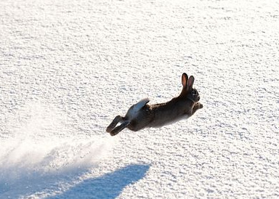
What can vw do?
Solve several problem types:
- Linear regression
- Classification (+ multi-class)
[using multiple reductions/strategies]
- Matrix factorization (SVD like)
- LDA (Latent Dirichlet Allocation)
- More ...
Team 12

Slide 5
Why vw?
Speed and scalability:
Unlimited data-size (online learning)
~5M features/second on my desktop
Team 12

Slide 6
Why VW?
The “hash trick”:
Feature names are hashed fast (murmur hash 32)
Hash result is index into weight-vector
No hash-map table is maintained internally
No attempt to deal with hash-collisions
num:6.3 color=red age<7y
Team 12

Slide 7
Why VW?
Very flexible input format:
Accepts sparse data-sets, missing data
Can mix numeric, categorical/boolean features in natural-language like manner (stretching the hash trick):
size:6.3 color=turquoise age<7y is_cool
Team 12

Slide 8
Why vw?
Name spaces in data-sets:
Designed to allow feature-crossing
Useful in recommender systems
e.g. used in matrix factorization
Self documenting:
1 |user age:14 state=CA … |item books price:12.5 …
0 |user age:37 state=OR … |item electronics price:59 …
Team 12

Slide 9
Feature hashing
Also known as hashing trick
fast and space-efficient way of vectorizing features i.e. turning arbitrary features into indices in a vector or matrix.
It works by applying a hash function to the features and using their hash values as indices directly, rather than looking the indices up in an associative array.
Team 12

Slide 10
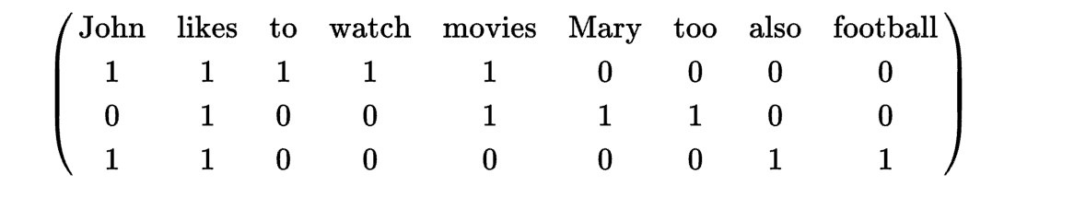
Problem example
John likes to watch movies.
Mary likes movies too.
John also likes football.
can be converted, using the dictionary
Term Index
Term | Index
John | 1
likes | 2
to | 3
watch | 4
movies | 5
Mary | 6
too | 7
also | 8
football | 9
term-document matrix
Team 12
Notes:
Machine learning algorithms, however, are typically defined in terms of numerical vectors. Therefore, the bags of words for a set of documents is regarded as a term-document matrix where each row is a single document, and each column is a single feature/word; the entry i, j in such a matrix captures the frequency (or weight) of the j'th term of the vocabulary in document i.

Slide 11
Problem
The problem with this process is that such dictionaries take up a large amount of storage space and grow in size as the training set grows.
On the contrary, if the vocabulary is kept fixed and not increased with a growing training set, an adversary may try to invent new words or misspellings that are not in the stored vocabulary so as to circumvent a machine learned filter.
This difficulty is why feature hashing has been tried for spam filtering at Yahoo! Research.
Team 12

Slide 12
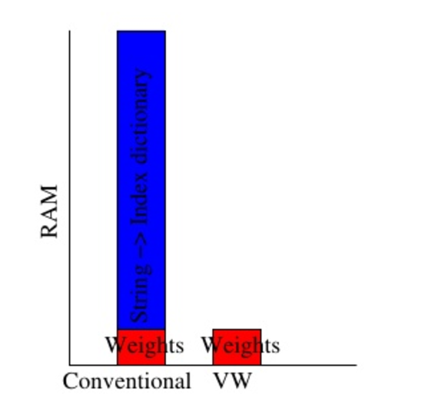
Feature Hashing String
Most algorithms use a hashmap to change a word into an index for a weight.
VW uses a hash function which takes almost no RAM, is x10 faster, and is easily parallelized.
Team 12

Slide 13
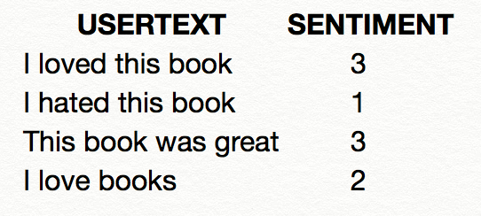
How Feature Hashing Works
For example, suppose you have a set of sentences like this one, with some text and a sentiment score that you want to use in building a model.
Team 12

Slide 14
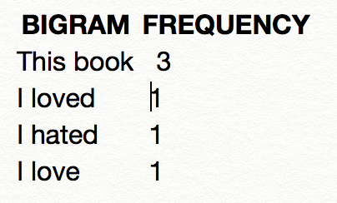
How Feature Hashing Works
Internally, the Feature Hashing module creates a dictionary
You can control the size of the n-grams by using the N-gramsproperty.
For example, the list of bigrams for this dataset would be something like this:
Team 12

Slide 15
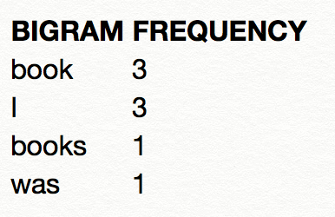
How Feature Hashing Works
Note that if you choose bigrams, unigrams are also computed. Thus, if you do not perform any lexical analysis (such as stemming or truncation) the dictionary would also include single terms like these:
Team 12

Slide 16
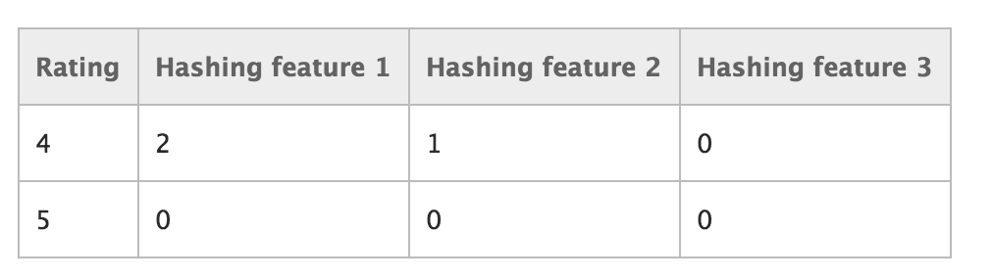
How Feature Hashing Works
After the dictionary has been built, the Feature Hashing module converts all of the dictionary terms into hash values, and computes whether a feature was used in each case. For each row of text data you provide as input, the module outputs a set of columns, one for each hashed feature.
For example, after hashing, the feature columns might look something like this:
If the value in the column is 0, the row did not contains the hashed feature.
If the value is 1, the row did contain the feature.
Team 12

Slide 17
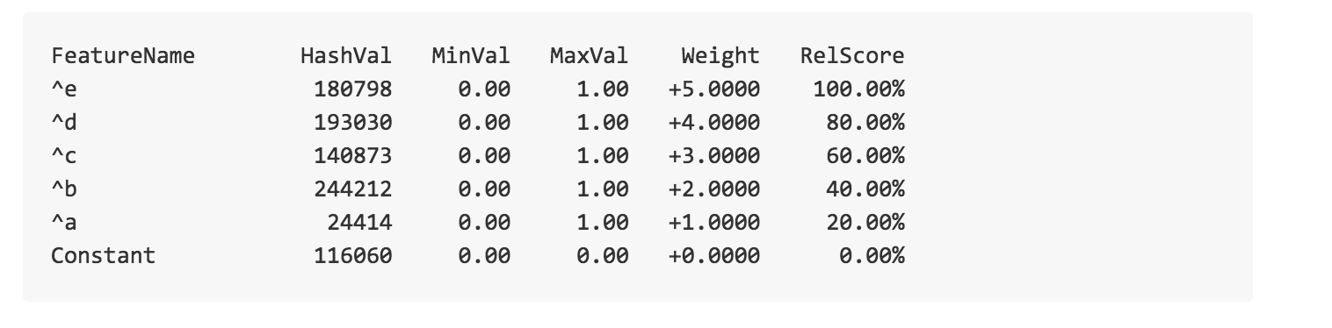
Output of training
vw-varinfo mydata.train
Team 12

Slide 18
PART TWO
Examples
01
AML
Adult Census Income Analysis by using Azure Machine Learning Studio
02
Python
Movie Review Sentiment Analysis by using Python in Linux System.
03
RStudio
Train and Test a model using VW
Team 12

Slide 19
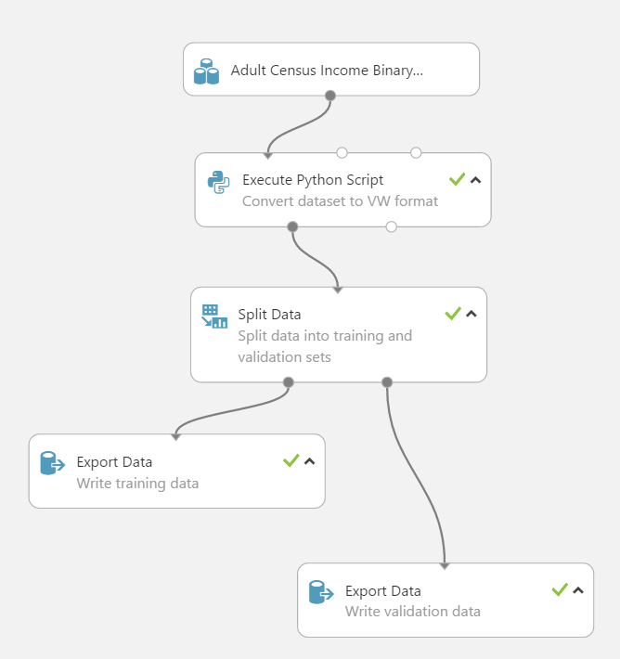
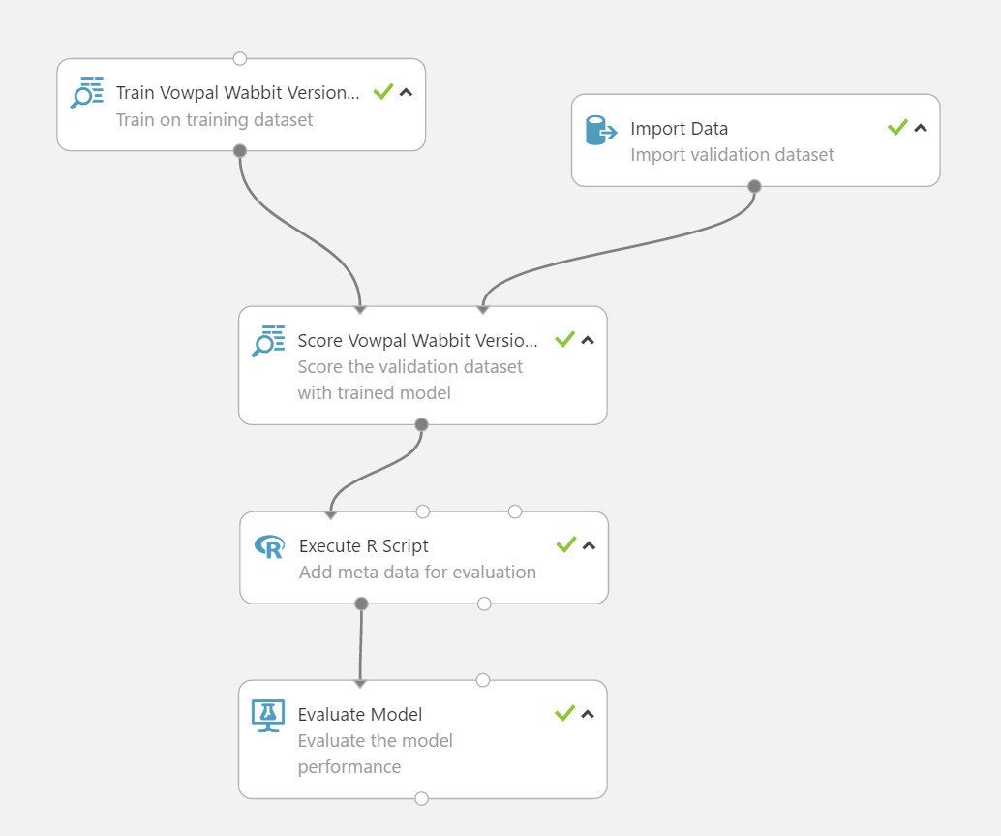
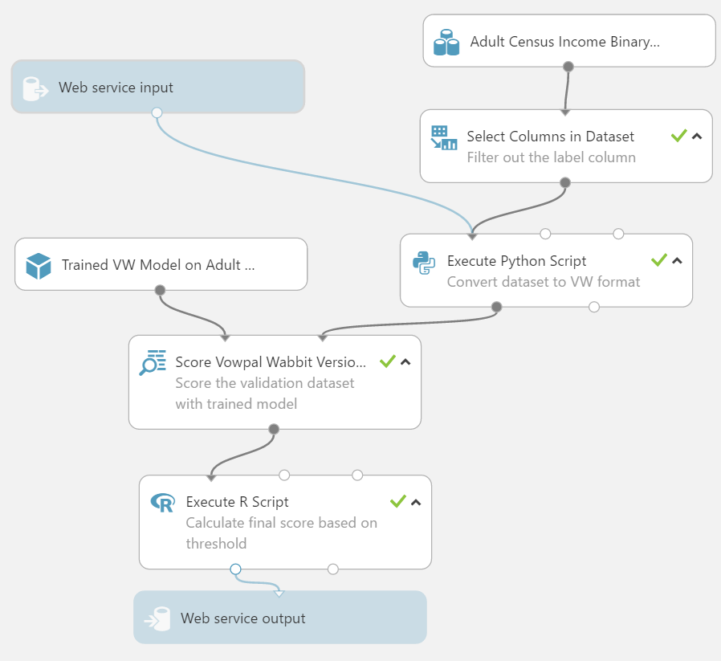
1. AML
Team 12

Slide 20
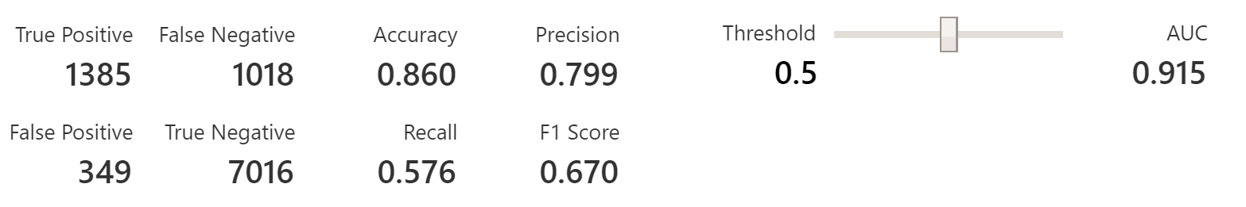
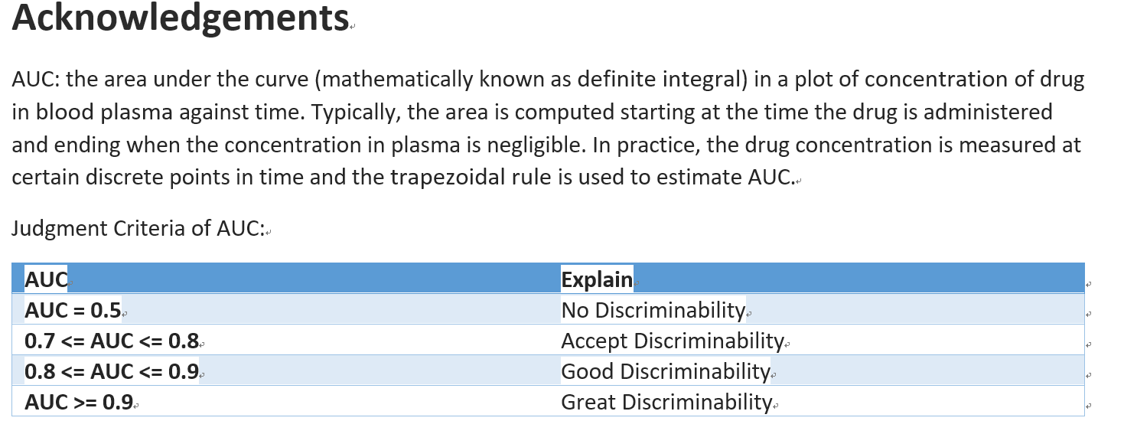
Team 12

Slide 21
2.Python in Ubuntu
# -- Get libboost program-options and zlib:
apt-get install libboost-program-options-dev zlib1g-dev
# -- Get the python libboost bindings (python subdir) - optional:
apt-get install libboost-python-dev
# -- Get the vw source:
git clone git://github.com/JohnLangford/vowpal_wabbit.git
# -- Build:
cd vowpal_wabbit
make
make test # (optional)
make install
Team 12

Slide 22
Vowpal Wabbit Python Wrapper
Installation
From PyPI:
$ pip install vowpalwabbit
From local repo (useful when making modifications):
$ cd python
$ pip install -e .
Usage
You can use the python wrapper directly like this:
>>> from vowpalwabbit import pyvw
>>> vw = pyvw.vw(quiet=True)
>>> ex = vw.example('1 | a b c')
>>> vw.learn(ex)
>>> vw.predict(ex)
Team 12

Slide 23
3. R scripts for vowpal wabbit
download the r.vw package
r.vw contains two functions: dt2vw and vw
installation requires devtools:
install.packages("devtools")
devtools::install_github("JohnLangford/vowpal_wabbit", subdir = "R/r.vw")
Convert a data.table to vowpal wabbit format: dt2vw()
Allows to convert the data.table in chunks using the append=TRUE option.
Call vowpal wabbit from R: vw()
It also computes the AUC on a validation test set and plots the ROC curve if needed.
Team 12

Slide 24
THANK YOU
FOR WATCHING
Q&A?
PRESENTED BY PRITI, YALIN, ZHI

